Slide 1


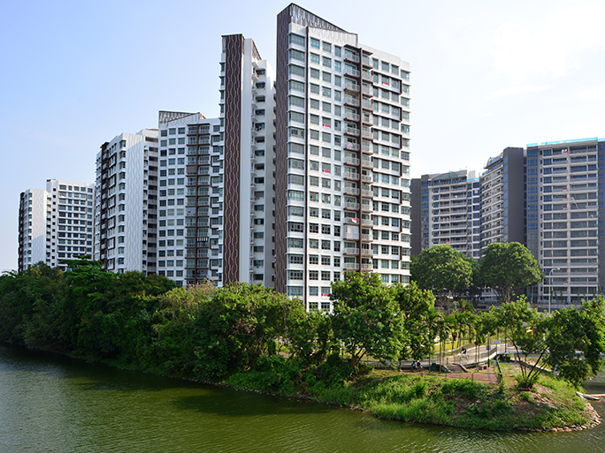

CHANGING DEMOGRAPHICS AND ITS IMPACT ON LOCAL PUBLIC HOUSING PRICES IN SINGAPORE
TEAM 053
TAI JIN YAO
RAM CHARAN SINGH
ARIF RACHMAN
GAN HONG YEE
REGINALD LIM
Notes:
Hi Manager, I am Jin Yao My team, and I will be sharing on our project which studies the changing demographic and impact on local public housing prices in Singapore in the order as shown on the slide

Slide 2
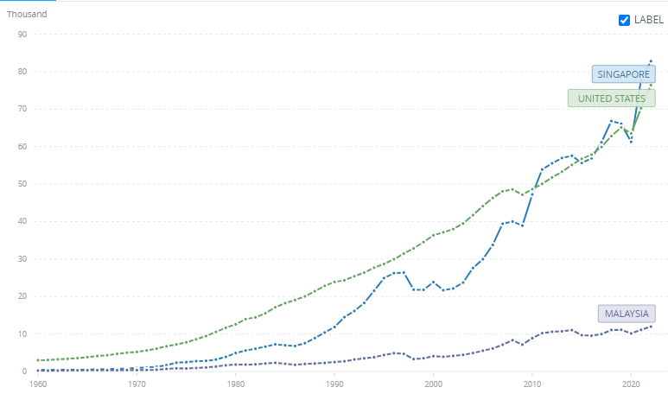
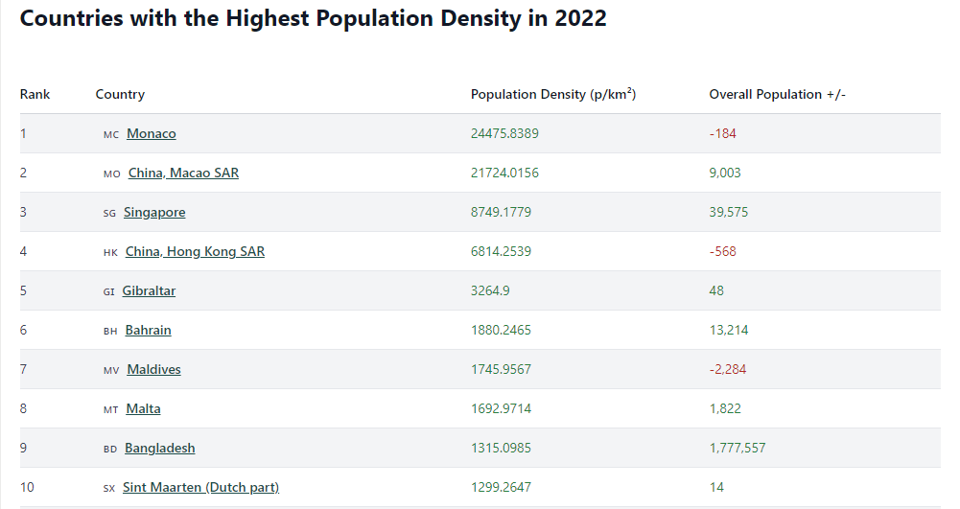
Singapore as a Country
Strong GDP per capita
Highly density country
Source: Data.Worldbank.org
Source: database.earth
Notes:
To commence, I'd like to share some background information about our country, Singapore.
Singapore, a small Asian nation, stands out as one of the highly developed countries with a GDP per capita of approximately 73 thousand USD dollars
The country's remarkable development has led to a dense population, with approximately 8700+ individuals per square kilometer. This makes Singapore the third most densely populated country worldwide, trailing Monaco and Macao.

Slide 3
Background
the Housing & Development Board (HDB) is a government agency, tasked with developing public housing estates in a manner that ensures affordability
>80% of Singapore’s resident population reside in HDB public housing or flats
Escalating prices in the past few years have raised concerns regarding the affordability of public housing
Housing Landscape
Public Housing
Private Properties
Notes:
To kick off our project, let me provide a brief overview of the different types of housing available in Singapore. The housing landscape in Singapore consists of two primary categories – public housing and private propertie.
For our project, we will be focusing on public housing.
In Singapore, the Housing & Development Board (HDB) plays a pivotal role in developing public housing estates with the primary objective of ensuring affordability for its residents. In fact, over 80% of Singapore's population currently resides in HDB public housing.
However the increasing prices over the last few years have caused worries about the affordability of public housing.

Slide 4
Problem Statement
With the steep increase in housing prices over salary increment, the HDB needs to provide better public housing opportunities for its citizens
 | 2001-2020 | 2021 | 2022
Housing Price to Income Ratio | 4.1 | 4.5 | 4.8
Our project hopes to facilitate better policy planning and outcomes for HDB through the study of the impact that changing demographic structure in Singapore has on the prices of resale public housing flats
Notes:
Our project is driven by the pressing problem of soaring public housing prices, which have far outpaced salary growth, exacerbating the affordability issue. The housing price to income ratio rose from 4.1 in 2001 to 4.8 in 2022, raising significant concerns, Our project aims to conduct a comprehensive study analyzing how demographic changes in Singapore directly influence resale public housing prices. By understanding this link, policymakers can make informed decisions to address the housing affordability challenge effectively.

Slide 5
Hypotheses
Increase in the younger age group segment (20-59 years) of the population likely to increase the demand of public housing more than other age groups
Increase in the older age group (>= 60 years) segment of the population may decrease the demand of public housing
Notes:
We have identified two key hypotheses Our first hypothesis suggests that the growing younger age group, spec, will drive an upsurge in the demand for public housing. These young individuals form new households and require suitable housing, making them a key group segment likely to influence housing demand.
Hypothesis 2: Impact of the Older Age Group
Our second hypothesis explores the impact of the older age group, specifically individuals aged 60 years and above, on the demand for public housing. As people reach retirement age, their housing requirements may change. Some may opt to downsize or move to retirement communities, potentially leading to reduced demand for larger or public housing units.
Next, I will invite my team member to present further details about the datasets utilized in this project.

Slide 6
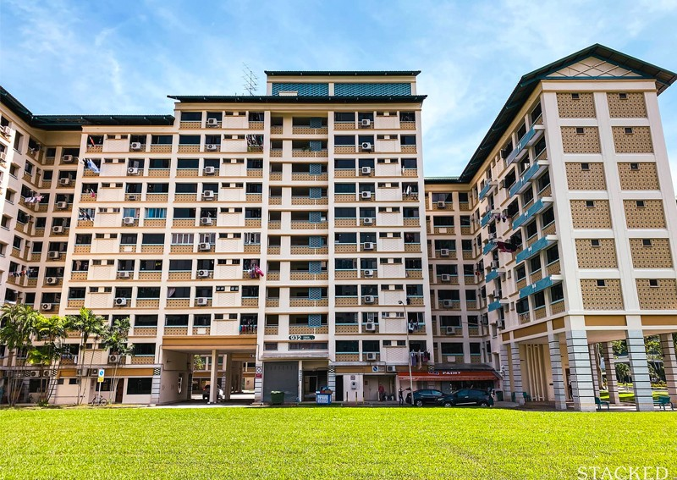
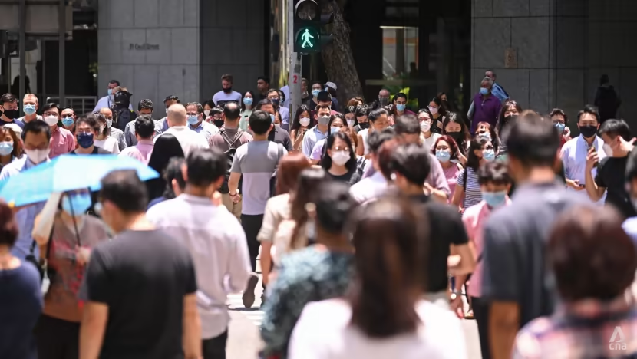
Datasets
HDB Flat Resale Price
Population Growth
Image Credit: AsiaOne.com
Image Credit: ChannelNewsAsia.com
Notes:
Thank you Jin Yao, let us now move on to the datasets we have acquired for our analysis.
As our problem statement is to address the impact of changing demographic structure on the prices of resale public housing flats, we naturally chose the HDB flat resale price dataset obtained from the official government website in Singapore and the population growth dataset.

Slide 7
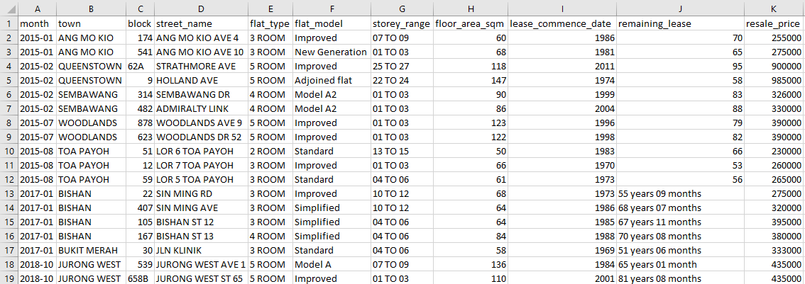
Datasets HDB Flat Resale price
Time
Location
Flat info
Lease and Price
Notes:
For the HDB Flat resale price dataset, there are 4 main components being time from 2015 to September 2022, location which comprises of the town, the public housing block number as well as the street address of the hdb.
It also has flat information such as the type of flat (whether it has 3 room or 4 rooms), the model of flat, the level that the house is on as well as the size of the house.
Lastly, it has lease information such as when the house was built, the remaining lease as well as our response variable, resale price, on the last column which indicates the price of the house at the point of time.

Slide 8
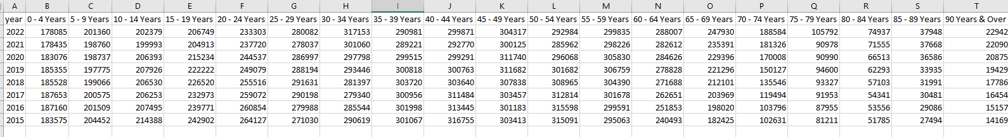
Datasets Population
Children
0-19 years old
Working Adult
20-59 years old
Senior Citizen
over 60 years old
There are 178085 individuals between the age of 0 to 4 years old in the year 2022.
Notes:
For the population growth dataset, we have the number of individuals within an age bracket for a particular year from 1950 to 2022. For example, there are 178085 individuals between the age of 0 to 4 years old in the year 2022.
We have decided to split the age columns into 3 main categories being children from the ages of 0 to 19 years old, working adults from the ages of 20 to 59 years old and senior citizens from 60 years and onwards.

Slide 9
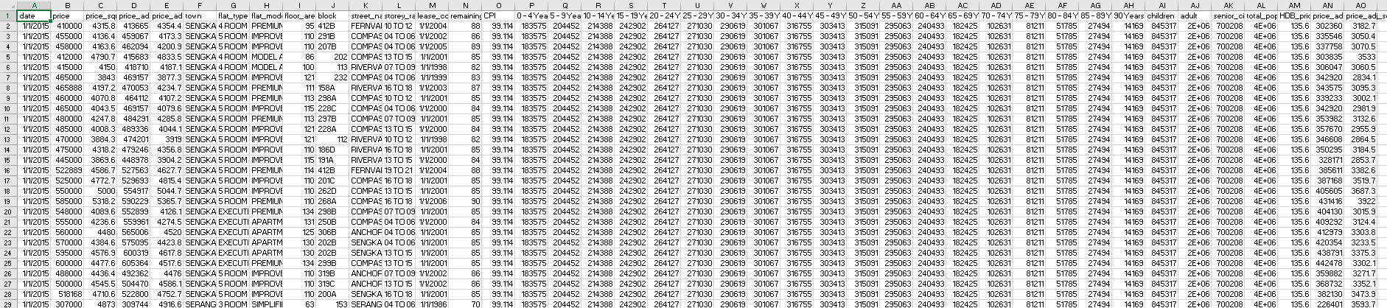
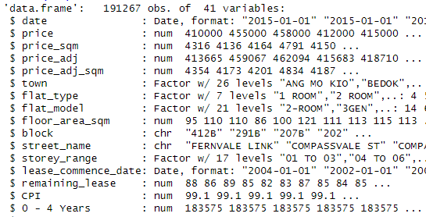
Datasets Merging
HDB Resale
Population
Price
191,267 obs.
41 variables
Notes:
Both datasets were then merged based on the year.
Each row of the final dataset now consists of the hdb resale information as you can see on the left along with the population numbers as you can see in the middle as well as the price at the end for each corresponding year.
After some data cleaning which my colleague will explain later on, we are left with a final dataset that has 191,627 rows as well as 41 variables.

Slide 10
Approach
Data Collection
Explanatory Data Analysis
Data Modelling
Data Cleaning
Feature Selection
Notes:
Before we move on to the analysis, let me take some time to explain our approach for this project which is broken down into 3 main stages for simplicity.
We first have data collection which was collected from the official Singapore government website as explained in our datasets breakdown.
Next, we did an initial explanatory data analysis to identify key trends and potential useful features that may correlate and explain our response variable. We also conducted data cleaning followed by feature engineering and feature selection on our final merged dataset.
Lastly, we moved on to data modelling which includes answering our hypothesis questions as well as using various regression techniques and evaluation methods to determine the best model that can explain our response variable.

Slide 11
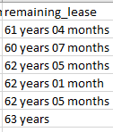
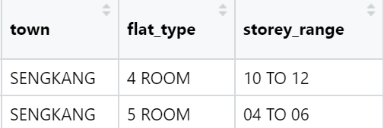

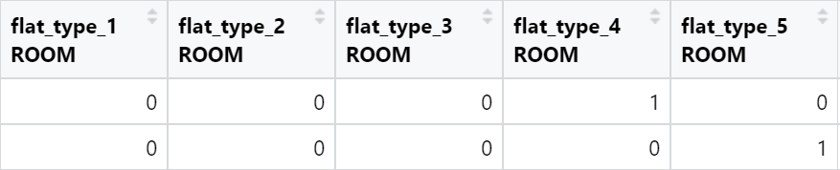
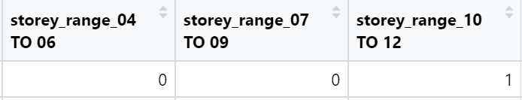
Data Preparation Data Cleaning and Dummy Variables
Texts to numeric conversion
Dummy Variable Creation
Notes:
After all data have been gathered and merged,
we did some data cleaning to transform data into a better format for our modelling.
For example,
Information about "Remaining Lease of the flats" were stored as a text,
we converted it into a numeric format.
Secondly,
Some of text variables such as Town, Flat type, Storey Range
we converted them into numbers, so we could bring them into our mathematical models.

Slide 12
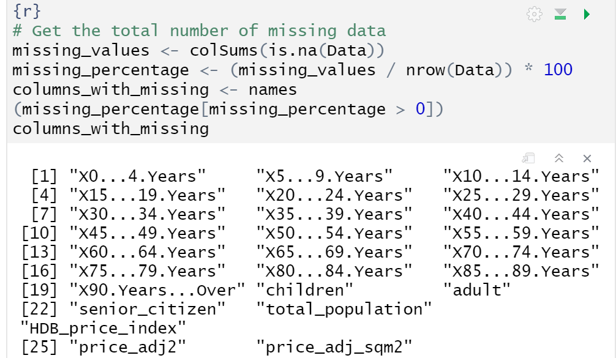
Data Preparation Missing Data
Housing Price data: Jan 2015 to May 2023
Housing Price Index: only until Sep 2022
Missing data identified: Oct 2022 – May 2023
No Imputation Since there's a large gap, we did not want to impute as it might result errors or uncertainty
Hence perform listwise deletion Result: our data from Jan 2015 to Sep 2022 – 7.75 years
Notes:
Unfortunately we found some missing pieces in our data.
Initially, we took Housing Price data from 2015 to 2023.
However when we merged the data with the other data, we realized that the other data was only available until Sep 2022.
Therefore there was a missing data around 8 months data, which is pretty large to fix by imputation,
we decided to remove the data.
Therefore we kept our data from 2015 to Sep 2022, which is around 7.75 years

Slide 13
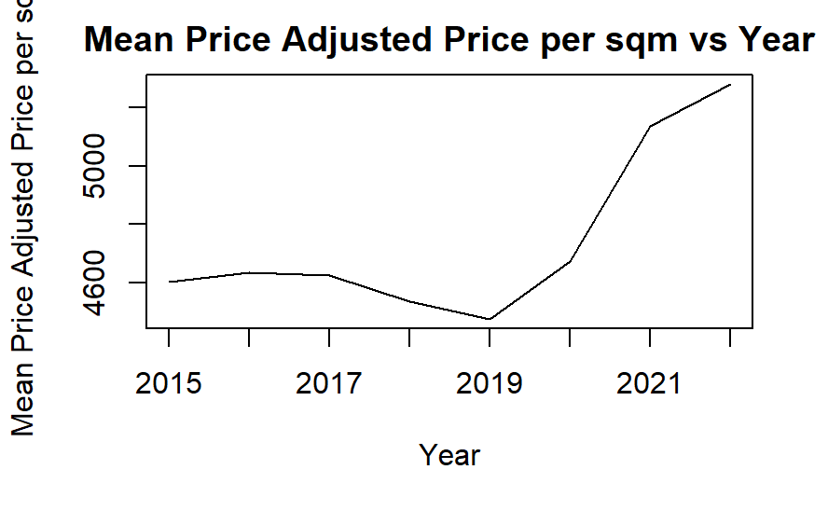
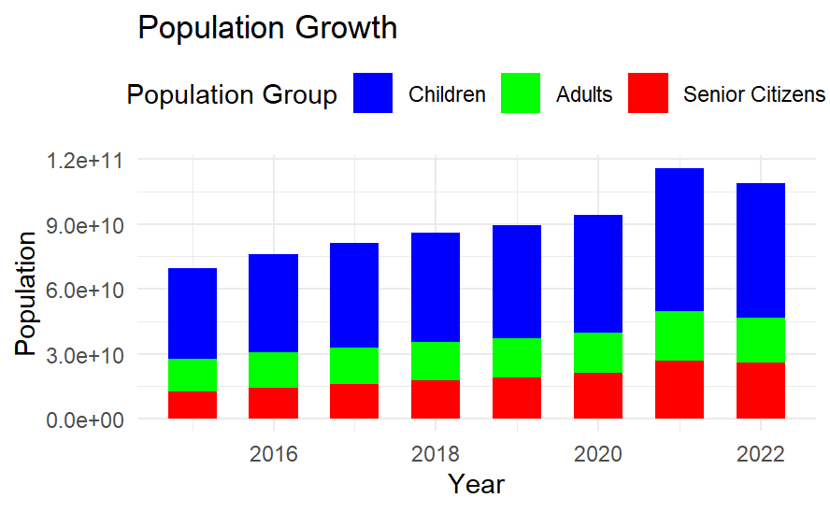
Explanatory Data Analysis Price vs. Population
The price per sqm trend seems to have spiked after 2019.
The population growth trends suggest that this might be one contributing factor.
Mean Adjusted Price per sqm
Year
Notes:
Here are some visualizations that we performed in order to understand the data better.
On the left chart, we can see a spike of housing price, starting from year of 2019.
There is a similar trend in population growth, on the right chart,
that suggest population might be one contributing factor

Slide 14
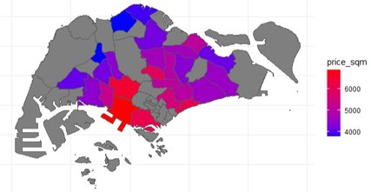
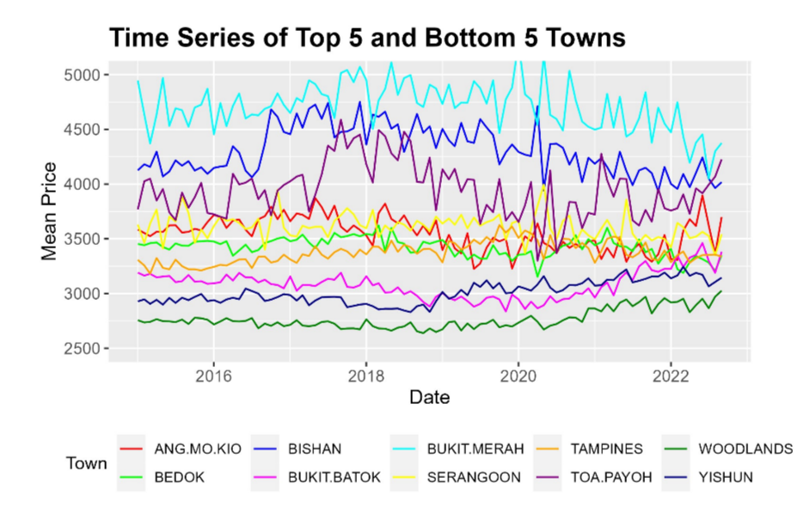
Exploratory Data Analysis Location
Notes:
Based on the geospatial visualization diagram on the left,
We can see that area in the red circle, which is the central region, exhibits higher housing prices per square meter.
And conversely the further we move away from the city center, to the purple and blue circles, they tend to have lower prices.
On the right side, we tried to find the top and bottom 5 of towns in regard of price,
To analyze the data more detail.

Slide 15
Features Selection 19 Selected Features
Town |  | Flat Model | Flat related Numeric | Demographic
Bukit Merah | Toa Payoh | DBSS | Storey median | 30_34 Years
Queenstown | Clementi | Type 3 room | Remaining lease | 80_84 Years
Central Area | Kallang/ Whampoa | Model Type S1 | Floor area sqm
Woodlands | Chua Chu Kang | Model Type S2 | Month
Bishan
Notes:
This slide shows the features selected.
The selection was based on previous exploratory data analysis and correlation with the dependent variable.

Slide 16

Analytic Modeling
Metrics | Model 1: Linear Regression (Linear-Linear) | Model 2: Linear Regression (Log-Linear) | Model 3: Decision Tree
Training R² | 77% | 79% | 57%
Training RMSE | 76,815 | 495,022 | 105,582
Validation R² | 77% | 76% | 56%
Validation RMSE | 76,412 | 494,503 | 105,979
Linear-Linear Model is chosen because its validation R² and RMSE is lowest.
Selected model has minimal overfitting as R² and RMSE is consistent at 77% and 76 thousand for training, validation and test set.
Test R² | 77%
Test RMSE | 76,941
Notes:
Next, three models were developed. The first model is a multiple linear regression, that incorporates all the features identified in the earlier feature selection.
The second multi-linear regression is built by log-transforming the dependent variable.
Lastly, a decision tree was built as an alternative to the linear regression models.
Eventually, Linear-Linear Model is chosen because its validation R2 and RMSE is lowest.
This model also exhibit minimal overfitting as R2 and RMSE is consistent for training, validation and test set.
None of the features exhibited a VIF greater than 5, indicating the absence of multicollinearity.
All variables also have p values that were statistically significant.

Slide 17
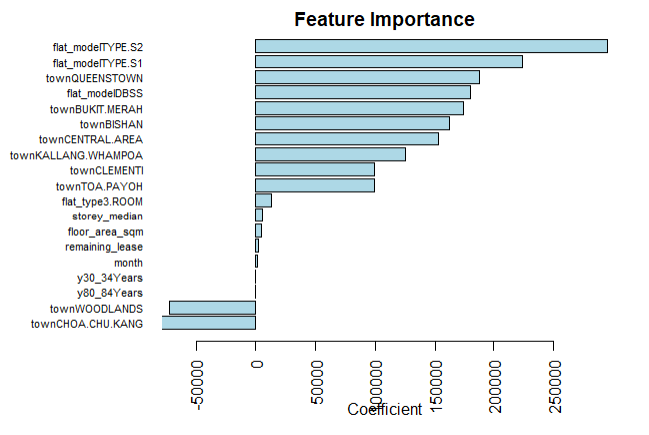
Top Feature Predictors
Flat Model
Type S2: 295162
Type S1: 224029
DBSS: 180079
Town
Queenstown: 187264
Bukit Merah: 174072
Bishan: 162372
Woodlands: -71871
Choa Chu Kang: -78545
Population
30-34 years old: 2.613
80-84 years old: 0.839
Notes:
Based on the best model, top predictors were flat model type S1, S2 and DBSS, Queenstown, Bukit Merah and Bishan.
Demographic variables, on the other hand, have minimal impact on housing prices, based on their regression coefficients.
Homes located in Woodlands and Choa Chu Kang are found to have high negative influence on housing prices.

Slide 18
Conclusion
Flat Model and Town are the 2 most crucial factors to HDB price
Demographic population has minimal effect to HDB price despite statistically significant correlation with housing prices
→ 30-34 years old: A unit increase increases home prices by $2.61
→ 80-84 years old: A unit increase increases home prices by $0.84
Notes:
As a conclusion, we found that Flat Model and Town, are the 2 most crucial factors that influence HDB price.
While demographic population, though it correlates to housing prices,
It has minimal effect to HDB price.
Increase in population may increase home prices by 1 or 2 dollars, while the housing price is in hundred thousand dollars.

Slide 19
Our Initial Hypotheses and Questions
Does local population demographics affect the resale public housing prices?
→ It does not affect significantly
Does the rate of increase in a particular age group result in a greater than proportionate rate of increase in public housing prices?
→ No
Does an ageing population result in overall higher public housing prices?
→ No
Notes:
Our conclusion leads us the answer to our initial hypotheses and research questions,
That local population demographics doesn't affect resale public housing prices.
There is no significant effect as well in increase particular of age group.

Slide 20
Recommendation
To the Singapore Government
To Investors & Property Developers
Build more public houses in popular areas
Queenstown, Bukit Merah, Toa Payoh, Clementi, Kallang, Bishan
Build more sought-after public housing types in crucial areas
S2, S1 and DBSS
Woodlands & Choa Chu Kang
Purchase estates in these cheaper areas for low-middle income buyers
Woodlands & Choa Chu Kang
Notes:
We would like to recommend to the Singapore government,
In order to lower the housing prices, build more public houses in popular areas,
Such as Queenstown, Bukit Merah, Toa Payoh and others as mentioned in this slide.
Secondly, to increase popularity in towns that has cheap price such as Woodlands and Choa Chu Kang,
To build public housing types that are sough-after by public such as S2 , S1 and DBSS.
To Investor and Property Developers,
We recommend to purchase estates in Woodlands and Choa Chu Kang, if they target low-middle income buyers.

Slide 21
Sources
[1] “HDB | Public Housing – A Singapore Icon - Housing & Development Board,” https://www.hdb.gov.sg/about-us/our-role/public-housing-a-singapore-icon (accessed June 1, 2023).
[2] “Commentary: Supply-demand imbalances in HDB market will need time to clear,” https://www.channelnewsasia.com/commentary/hdb-public-housing-bto-affordability-accessibility-supply-demand-3259186 (accessed June 15, 2023)
[3] “The Unassuming Economist,” The Unassuming Economist A Look at Housing Affordability in Asia Comments https://unassumingeconomist.com/2019/12/a-look-at-housing-affordability-in-asia/ (accessed June 16, 2023)
[4] “Is Public Housing Still Affordable For The Average Singaporean Couple?” https://blog.seedly.sg/is-public-housing-still-affordable-for-the-average-singaporean-couple/ (accessed June 17, 2023)
[5] “Resale Flat Prices” Data.gov.sg. https://data.gov.sg/dataset/resale-flat-prices (accessed June 12, 2023)
[6] “A Global Database of Inflation,” World Bank. https://www.worldbank.org/en/research/brief/inflation-database (accessed June 12, 2023)
[7] “Population and Population Structure,” Base. https://www.singstat.gov.sg/find-data/search-by-theme/population/population-and-population-structure/latest-data (accessed June 18, 2023)
[8] “How To Adjust For Inflation In Monetary Data Sets,” Time Series Analysis, Regression, and Forecasting https://timeseriesreasoning.com/contents/inflation-adjustment/#:~:text=As%20we%20have%20seen%2C%20you,multiplying%20the%20result%20by%20100.&text=This%20is%20an%20important%20formula (accessed June 17, 2023)
Notes:
Here are some sources that we took while developing this research

Slide 22
Thank you

Slide 23
Introduction & Problem Statement - Jin Yao
Data & Approach - Ram
EDA - Arif
Modelling – Hong Yee
Conclusion & Recommendation – Reginald

Slide 24
Recommendation
to lower the HDB resale price, meet customers demand preferences:
HDB agency to build more flats with type : S2, S1 and DBSS
Increase supply in these popular areas: Queenstown, Bukit Merah, Toa Payoh, Clementi, Kallang, Bishan

Slide 25
Planned Approach
Data Cleaning
Feature Engineering
Feature Selection
Model Building
Model Tuning
Model Selection
Address Missing Values
LOCF
Imputation
Remove Duplicates
Outlier Treatment
QQ plot
Histogram
Grubb’s Test
Merge Datasets
Using year-month identifier
Adjust for inflation
Using Consumer Price Index
Encode Categorical Variables
Create Interaction Variables
Correlation Matrix
Variable Inflation Factor
Principal Component Analysis
Train-Validation-Test Split
70:15:15 ratio
Mean/Median
Stratification across different time periods
Data Scaling
Train Model
Regularization
L1 & L2
Hyperparameter Tuning
Random Search
Grid Search
Adjusted R²
Root Mean Squared Error
AIC/BIC
Cross Validation

Slide 26
Background
In Singapore, the Housing & Development Board (HDB) is tasked with developing public housing estates in a manner that ensures affordability
More than 80% of Singapore’s resident population currently reside in HDB public housing or flats
Escalating prices in the past few years have raised concerns regarding the affordability of public housing
Certain demographic groups, especially young couples, find owning their own homes becoming out of reach
Pace of public housing price increases greatly outweighs salary growth

Slide 27
Models
Multiple linear regression
Polynomial regression
Non-Linear Regression
Regression trees
Random forest

Slide 28
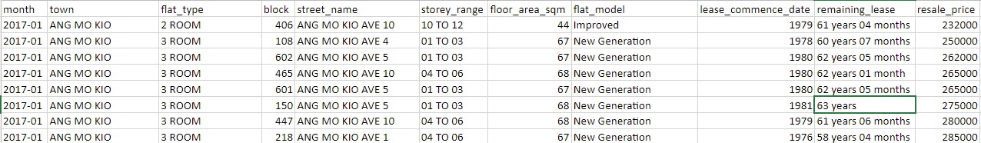
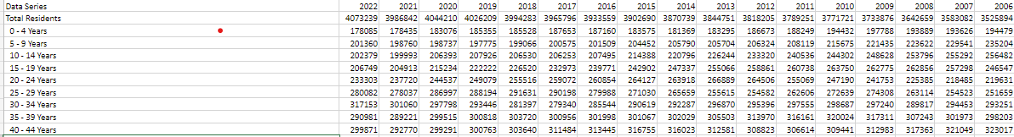
Datasets
Dataset 1: HDB resale data (Source: https://data.gov.sg/dataset/resale-flat-prices)
- 11 Attributes describing public housing such as address, size of the flat and resale price
Dataset 2: Consumer Price Index (CPI) data (Source: https://www.worldbank.org/en/research/brief/inflationdatabase)
- Time series data regarding various countries’ CPI from 1970 to 2022
Dataset 3: Singapore Demographics data (Source: https://www.singstat.gov.sg/find-data/search-bytheme/population/population-and-population-structure/latest-data)
- Demographics consisting of Singapore’s population count, population growth and breakdown by age group covering the period 1950 to 2022

Slide 29
Data Preparation Data Cleaning
Merge the 2 separate datasets and align them by year or year/month
Some text fields are converted to numeric - e.g. "remaining lease" (example 89 years 06 months) are converted into numeric 89.5 years
Data irrelevant to our analysis has been excluded - e.g. population by gender and races

Slide 30
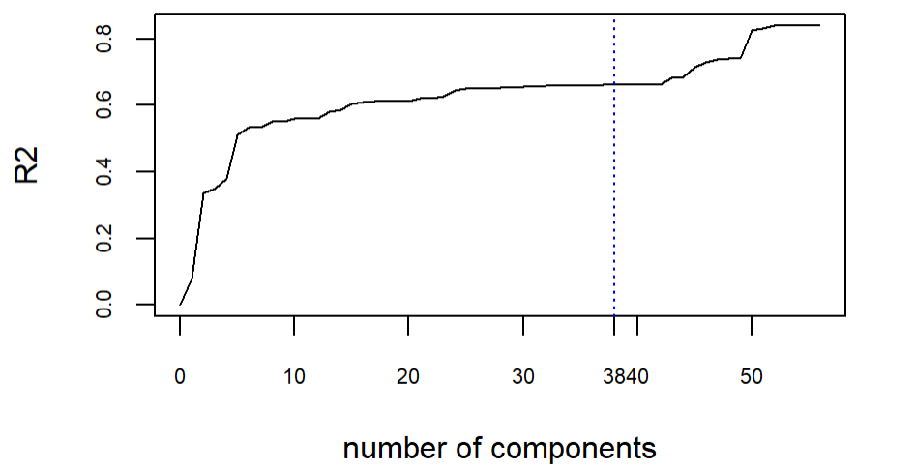
Principal Component Analysis/ Regression
Principal Component Regression is performed which is a technique to combines Principal Component Analysis with linear regression.
R2 is only at 0.6640

Slide 31
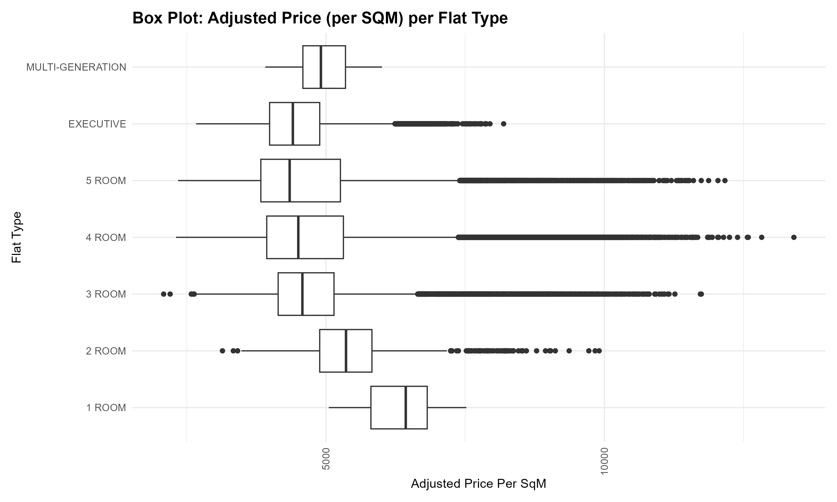
Preliminary Analysis
Based on the box plot, 3, 4 room and 5 room shows the largest proportion of outliers.
Statistical Analysis
 | 3 room | 4 room | 5 rooms
Mean Absolute Deviation | 719 | 965 | 937
IQR | 1003 | 1377 | 1429
Kurtosis | 8.25 | 5.6 | 5.63
Skewness | 1.93 | 1.54 | 1.50
→ Different flat types result in spread in prices or population

Slide 32

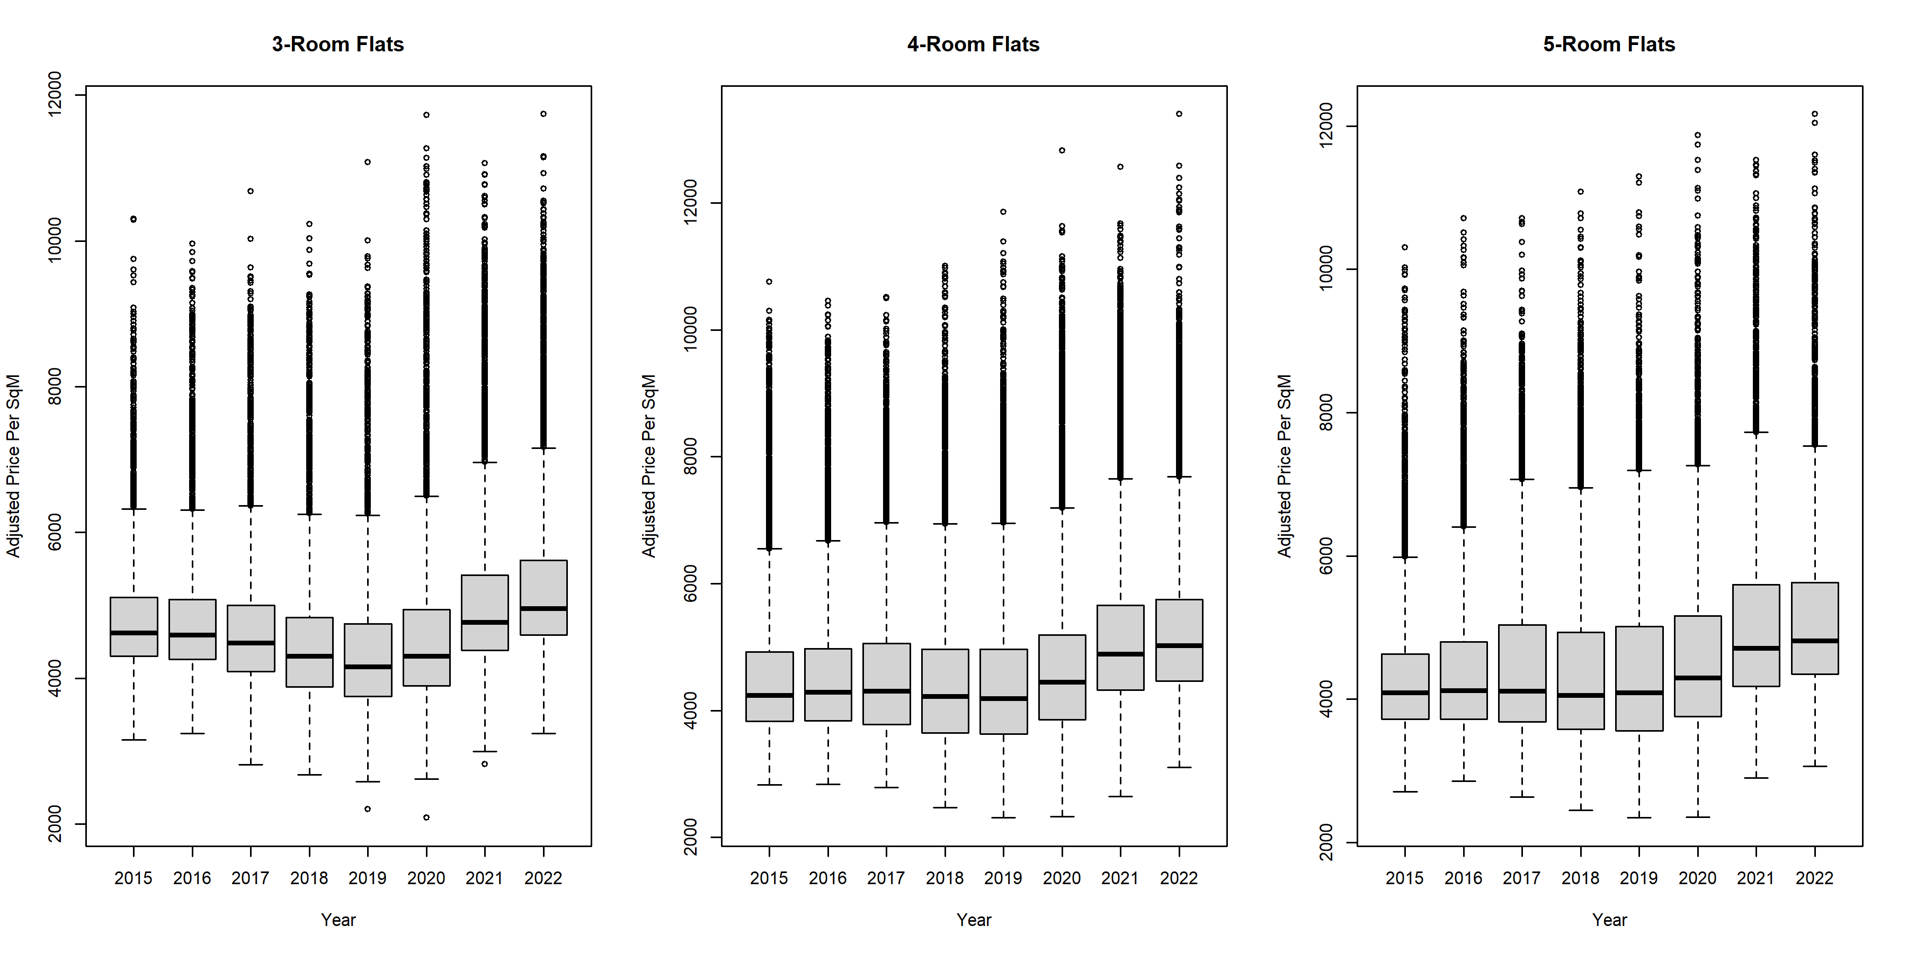

Preliminary Analysis
Splitting by flat area suggests
→ General upward trend
→ 2020 onwards
Notes:
This purpose is to show that previous chart outliers is not due to purely town area higher price but also when we break into different years we are seeing a general trend

Slide 33
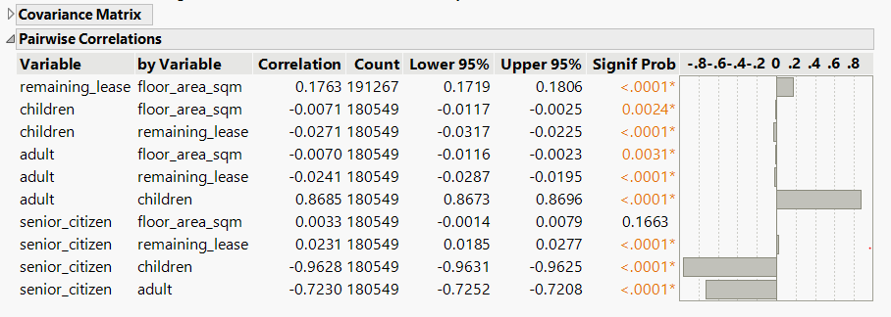
Pairwise Correlation
Strong correlation between adult, children and senior citizen
Notes:
The main objective that you want to talk about this is the correlation exist between the adult, children and senior citizen. It seems that senior citizen has a negative correlation to adult and children.

